Slide 1
Visual Analytics: Visual Thinking Conclusions
Ian Nabney
ian.nabney@bristol.ac.uk

Slide 2
Overview
Reading: Chapter 9 of Ware
Understand the role that visual thinking plays in information visualisation

Slide 3

The eye
The eye has a small high-resolution area of photoreceptors called the fovea.
We see far more detail in the fovea than off to the side and we sample the world by making rapid eye movements from point to point.
Eye movements rotate the eyeball so that imagery from different parts of the visual world falls on the fovea to be analyzed by the brain.

Slide 4
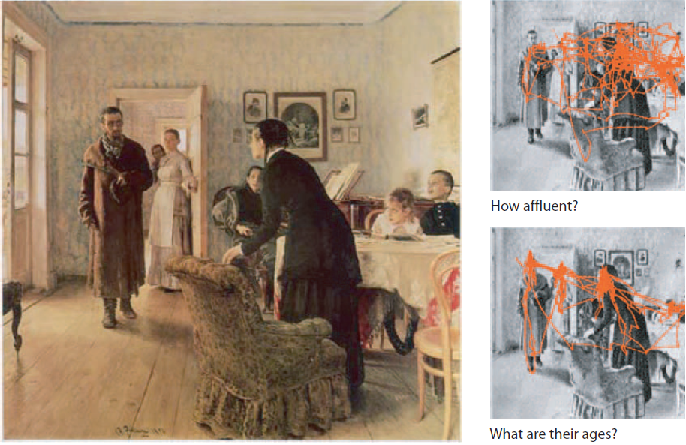
Visual queries

Slide 5
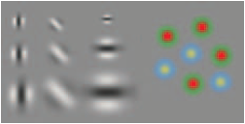
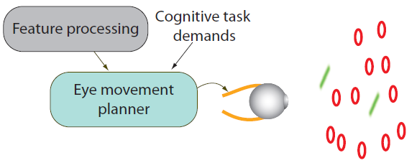
Local feature analysis
The first stage of cortical visual processing is a local feature analysis done simultaneously for every part of the visual field.
The orientation, size, colour, and motion of each part of the image falling on the retina is determined all at once by feature-selective neurons.
Smaller scale features are only analyzed in the fovea at the centre of vision.
All other visual processing is based on the initial division of the visual world into features.

Slide 6
Pattern processing
There are two major processing pathways
The where pathway has connections to various regions in the parietal lobe responsible for visually guided actions, such as eye movements, walking, and reaching to grasp objects.
The what pathway is responsible for identifying objects through a series of stages in which increasingly complex patterns are processed, each stage building on the previous one.
Between the low-level feature analysis and high-level object recognition is an intermediate pattern-finding stage. This divides visual space into regions bounded by a contour and containing similar textures, colours, or moving features.
In V4 more complex compound shapes are identify ed from patterns of features.
In the IT cortex neurons respond to specific meaningful patterns such as faces, hands, and letters of the alphabet.

Slide 7
Working memory
Various kinds of information (visual, language-based, actions) are combined in a temporary nexus of meaning.
From one to three meaningful nexuses can be formed every time we fixate on part of a scene.
Some of these may be held from one eye fixation to the next, depending on their relevance to the thought process.
This three-object visual working memory limit is a basic bottleneck in visual thinking.

Slide 8
Language processing
Language processing is done through specialized centres in the left temporal lobe.
Language understanding and production systems are specialized for a kind of informal logic exemplified by the “ifs,” “ands,” and “ buts ” of everyday speech.
This is very different from the visual logic of pattern and spatial arrangements.

Slide 9

Linking words and images
The natural way of linking spoken words and images is through diexis (pointing).
People point at objects just prior to, or during, related verbal statements, enabling the audience to connect the visual and verbal information into a visual working memory nexus.

Slide 10
Visual proxies
One way that visual displays support cognition is by providing aids to memory.
Small images, symbols, and patterns can provide proxies for concepts. When these proxies are fixated, the corresponding concepts become activated in the brain. This kind of visually triggered activation can often be much faster than retrieval of the same concept from internal long-term memory without such aids.
When an external concept proxy is available, access to it is made by means of eye movements which typically take approximately one-tenth of a second. Once the proxy is fixated, a corresponding concept is activated within less than two-tenths of a second.
It is possible to place upwards of thirty concept proxies in the form of images, symbols, or patterns on a screen providing a very quickly accessible concept buffer.
This only works when there are learned associations between the visual symbols, images, or patterns and particular concepts. Thus it may be culturally dependent.

Slide 11
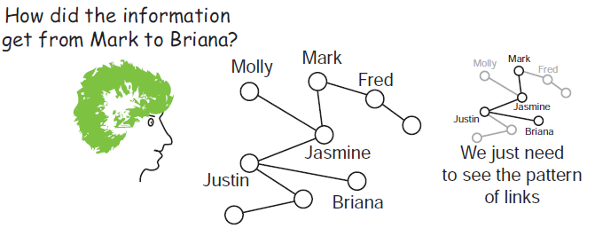
Pattern finding
Visual queries lead to pattern searches and seeing a pattern, such as a connection between two objects, often provides the solution to a cognitive problem

Slide 12

Long-term memory
Long-term memories are cognitive skills, rather than fixed repositories.
The pathways that are activated when a cognitive task is carried out become stronger if that task is successfully completed.
These pathways exist in all parts of the brain and on many levels; they are responsible for feature detection, pattern detection, eye movement control, and the sequencing of the cognitive thread.
Activated long-term memories are essentially reconstructions of prior sequences of neural activity in particular pathways.
Certain external or internal information can trigger these sequences. In the case of pattern recognition the sequences are triggered by visual information sweeping up the ‘what’ pathway.

Slide 13
Summary of visual thinking
Visual thinking is based on a hierarchy of skills. Sophisticated cognitive skills build on simpler ones.
The process whereby cognitive activities become automated is absolutely critical in the development of expertise because of the fundamental limitations of visual and verbal working memory capacities.
The active vision model has four broad implications for design.
To support the pattern-finding capability of the brain; that is, to turn information structures into patterns.
To optimize the cognitive process as a nested set of activities.
To take the economics of cognition into account, considering the cost of learning new tools and ways of seeing.
To think about attention at many levels and design for the cognitive thread.

Slide 14
Case study: humpback whale behaviour
First attempt to provide an analysis tool was to create a program that allowed ethologists to replay a moving three-dimensional model of the whale at any desired rate.
They were initially thrilled because for the first time they could see the whale’s underwater behaviour.
Nevertheless, although the visualization tool did its job, analysis was extremely time consuming. It took many hours of watching to interpret an hour’s worth of data.
The whale movements were replayed by an ethologist looking for stereotyped temporal sequences of movements.
When something promising was observed the analyst had to remember it in order to identify similar behaviours occurring elsewhere in a record.

Slide 15
Second design
Took much greater advantage of the brain’s pattern-finding ability.
Transformed the track of the whale into a 3D ribbon and added a sawtooth pattern above and below the ribbon that was derived from calculated accelerations indicating the fluke strokes of a whale.
This allowed for much more rapid identification of behaviour patterns and a very different visual thinking process.
The ethologist could quickly zoom in on a region where feeding behaviours were seen and stop to view a static image. Behaviour patterns could be identified by visually scanning the image looking for repeated graphic patterns.
Because eye movements are so fast and static patterns can be picked out efficiently, this method enabled analysts to compare several patterns per second . This process was hundreds of times faster than the replay method.

Slide 16
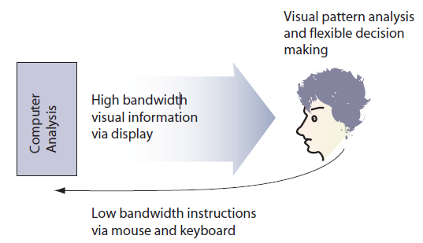
Optimising the cognitive process
Good design optimizes the visual thinking process. The choice of patterns and symbols is important so that visual queries can be efficiently processed by the intended viewer.
Computer programs are cognitive processes that have been standardized and translated into machine executable form. They offload cognitive tasks to machines, just as mechanical devices, like road construction equipment, offload muscle work to machines.
Once offloaded, standardized cognitive tasks can be done blindingly fast and with little or no attention.
It is useful to think of the human and the computer together as a single
cognitive entity, with the computer functioning as a kind of cognitive coprocessor to the human brain. Low-bandwidth information is transmitted from the human to the computer via the mouse and keyboard, while high-bandwidth information is transmitted back from the computer to the human for flexible pattern discovery via the graphic interface.

Slide 17

Learning and the economics of cognition
All cognitive activity starts off being diffi cult and demanding attention.
As we develop skills the neural pathways involved in performing the task are strengthened. These neural pathways carry particular patterns of activation, and strengthening them increases the efficiency of sequences of neural firing. The cognitive process becomes more and more automatic and demands less and less high-level attention.
When confronted by a new tool, we do a kind of cognitive cost-benefit analysis weighing the considerable cost in time and effort and lost productivity against the benefit of future gains in productivity or quality of work.
The professional will always go for tools that give the best results even though they may be the hardest to learn because there is a long-term payoff.
For the casual user sophisticated tools are often not worth the effort.
This kind of decision making can be thought of as cognitive economics. Its goal is the optimization of cognitive output.

Slide 18
Cognitive economics
How radical should one make the design? Making radically new designs is more interesting for the designer and leads to kudos from other designers. But radical designs, being novel, take more effort on the part of the user who must learn the new design conventions and how they can be used.
The idea of an economics of cognition can be fruitfully applied at many cognitive scales.
It can be used to explain the moment-to-moment prioritization of cognitive operations.
It can even be applied at the level of individual neurons. Sophie Deneve of the Institute des Sciences Cogitives in Bron, France, has developed the theory that individual neurons can be considered as Bayesian operators, “accumulating evidence about the external world or the body, and communicating to other neurons their certainties about these events.”

Slide 19
Attention and the cognitive thread
At the early stage of visual processing, attention biases the patterns which will be constructed from raw imagery.
Attention is also the very essence of eye movement control because looking is a prerequisite for attending. The planning of eye movements is therefore the planning of the focus of attention, and the sequence of eye fixations is intimately tied to the thread of visual thinking. We look where we think we will find something.
Visual working memory is a process that is pure attention. It is a momentary binding together of visual features and patterns that seem most relevant to the cognitive thread.
There is a basic cycle of attention. Between one and three times a second our brains query the visual environment, activate an eye movement to pick up more information, process it, and re-query. The information picked up becomes the content of visual working memory.
To add to the diversity of attention, the cognitive thread shifts back and forth between visual processing and language-processing modalities.
It is when visual and language modalities are combined that the brain is most effective. A well-designed presentation, for example, will use words and graphics, each to convey different kinds of information which are linked using pointing or simple proximity in space and time.

Slide 20
And finally…..
Work with the psychophysics: more impact and more universal
Visual design must take into account both the relatively fixed capacities of the human brain as well as the evolving skill sets of people who use sophisticated and powerful cognitive tools.
Interactive design is becoming ever more important as the loop coupling humans and computers tightens.
The visual system will always be the highest bandwidth sense by far, and making full use of its flexible pattern-finding capabilities can provide great benefits.

